Slide 1
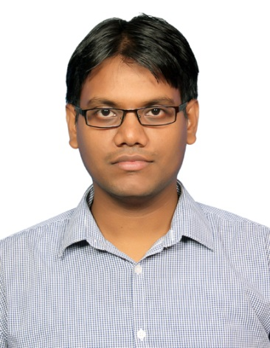
Mahantayya Hiremath – Developer
Profile
Skills and Expertise
Mahantayya has an experience of 11+ years in the industry, with an excellent exposure to various products and platforms in the Telecom Industry.
Mahantayya has around 6.5 years of onshore working experience with Orange, EE, Amdocs (Bristol, Leeds)
Highly experienced in application design, analysis, development, unit testing, security fixes .
Contributed to major EEs critical projects like DTP migration, Colorado, Auto Switch, Prepaid Plans, Tariff refresh etc.
Highly experienced in designing & developing client/server applications for Telecom and web self serve enterprise portals used by millions of customers.
Mahantayya is an optimistic person with a positive attitude possessing excellent communication, interpersonal and problem solving skills.
Hard working, Quick learner and ability to grasp new technologies very quickly.
Full-stack developer with multi level technical exposure. Currently a core member and developer of MyEE web APE squad and managed to contribute and deliver with high degree of excellence.
Proficient in Java EE architecture and technologies
Trained in Adobe CQ5, with fair understanding of core concepts and hands on the tool.
Worked in Agile with scrum methodology and waterfall models
Handson experience in creating architecture blueprints including required Cloud Services like AWS (such as EC2, S3, IAM, EBS, RDS, VPC, Subnet, Cloudformation etc) and Heroku.
Tech experiences in: Java, JSP, Adobe CQ5 trained, Spring, Spring Boot, OSGI, Netonomy, HTML, CSS, XML, JavaScript , Rest API, MySQL, Informix, Postgres, Karaf, Nginx, SVN, Clearcase, Git, ANT, Maven, Tomcat, Jetty, C, 4GL, Unix scripting, MQs, CHEF, Docker, Cucumber and Joomla CMS tools.
Maven, Jenkins, Pipeline scripts, Nexus, Pipelines, Github, Bitbucket, Wiremock, Hipchat and Slack BOTs
Proficient on Atlassian Products like JIRA, Confluence
Wholesale & Ventures
Group
Global Services
PlusNet
Consumer
Highlights
Key Responsibilities
Contributing towards all artefact involved in the development cycle - Technical Architecture Documents, Functional Design Specification, 3D specs and all technical design specs.
Designing and implementing business requirements taking future platform migration and performance factors into consideration
Contributing in devops tasks, setting up Jenkins jobs and pipeline scripts, Hipchat and Slack BOTs.
Major contributions in API service virtualisation to ease development activities using tools like wiremock and Jenkins jobs.
Active member in deciding the estimates during Scrum ceremonies planning, grooming sessions for the squad. Providing feedbacks for improvements in retro sessions.
Working on technical debts and fortify security incidents .
Analyse and fine tune the performance of enterprise application like MyEE web based on reports from monitoring tools like Dynatrace.
Pre-Release activities- Release notes and Operations Module document preparation and walkthrough
Release night support and post release support.
Actively involved in providing the inputs to improve the process, overall delivery, key improvement areas in close liaison with EE principals.
Good Analytical Skills and ability to work in diversified remote located nearshore and offshore multi vendor teams.
eService, Data addons, Karaf to Casper migration
Denver, Data addons
DTP Migration
Prepaid Plans
Colorado
Auto switch
Tariff plan refresh 2019
Key Projects

